Slide 1
EEE 111 Diode Applications
Topic 2 (Chapter 2)

Slide 2
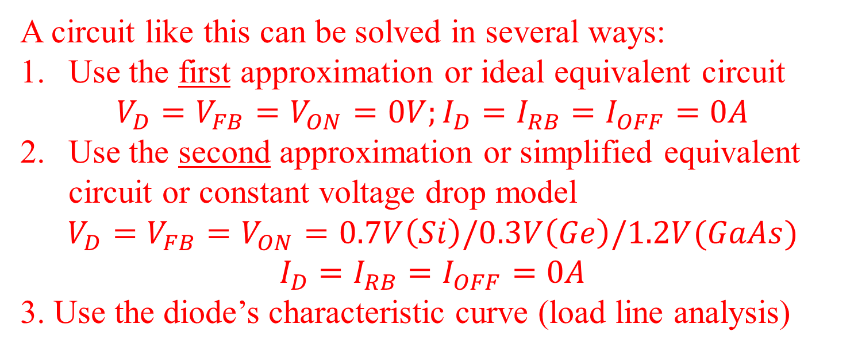
Solving Diode Circuits
R_{S} = 1 kΩ
V_{S} = 15 V
A circuit like this can be solved in several ways:
Use the first approximation or ideal equivalent circuit
$$V_{D}=V_{FB}=V_{ON}=0V;I_{D}=I_{RB}=I_{OFF}=0A$$
Use the second approximation or simplified equivalent circuit or constant voltage drop model
$$V_{D}=V_{FB}=V_{ON}=0.7V\left(Si\right)/0.3V\left(Ge\right)/1.2V(GaAs)$$
$$I_{D}=I_{RB}=I_{OFF}=0A$$
3. Use the diode’s characteristic curve (load line analysis)

Slide 3
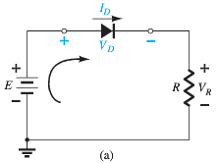
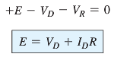
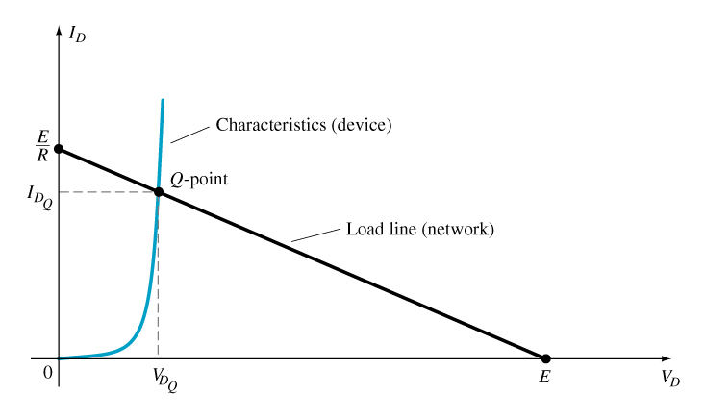
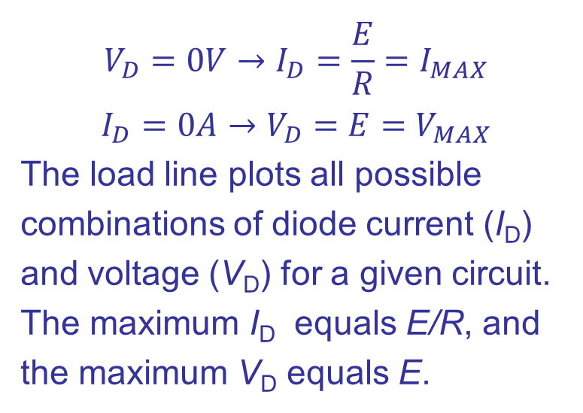
2.2 Load-Line Analysis
$$V_{D}=0V→I_{D}=\frac{E}{R}=I_{MAX}$$
$$I_{D}=0A→V_{D}=E=V_{MAX}$$
The load line plots all possible combinations of diode current (I_{D}) and voltage (V_{D}) for a given circuit. The maximum I_{D} equals E/R, and the maximum V_{D} equals E.
The point where the load line and the characteristic curve intersect is the Q-point, which identifies I_{D} and V_{D} for a particular diode in a given circuit.

Slide 4
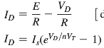
Load-Line Analysis
The solution found by load-line analysis is similar to that obtained by a simultaneous solution of
(assuming this theoretical diode curve is very close to the actual curve.)
The mathematics involved would require the use of nonlinear techniques that are beyond the needs and scope of this course.

Slide 5
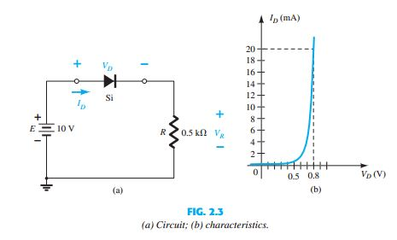
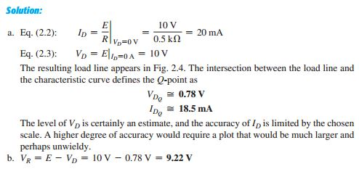
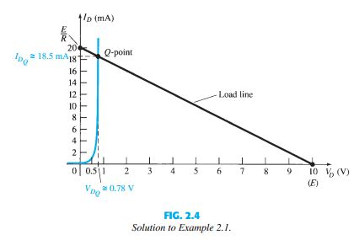
EXAMPLE 2.1
For the series diode configuration of Fig. 2.3a, employing the diode characteristics of Fig. 2.3b, determine:

Slide 6
Demonstration of Load Line Analysis
20.0
17.5
1 kΩ
15.0
15 V
12.5
Load line
10.0
Q
Forward current in mA
.
7.5
15 V
I_{SAT} =
= 15 mA
1 kΩ
5.0
V_{CUTOFF} = 15 V
2.5
0
0
5
10
15
Source voltage in volts
Q is the operating point or quiescent point

Slide 7
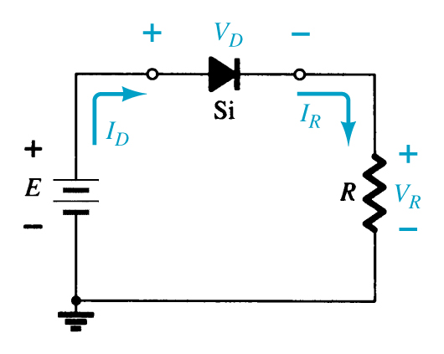
2.3 Series Diode Configurations
The forward resistance of the diode is usually so small compared to the other series elements of the network that it can be ignored.
In general, a diode is in the “on” state if the current established by the applied sources is such that its direction matches that of the arrow in the diode symbol, and V_{D} ≥ 0.7 V for silicon, V_{D} ≥ 0.3 V for germanium, and V_{D} ≥ 1.2 V for gallium arsenide.

Slide 8
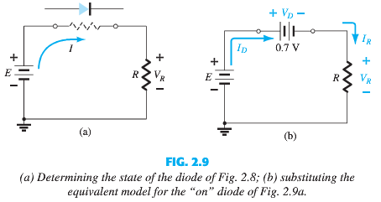
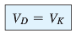
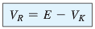
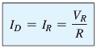
2.3 Series Diode Configurations

Slide 9
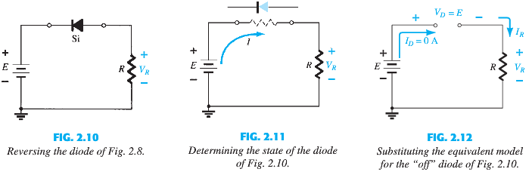
Reversing the diode

Slide 10
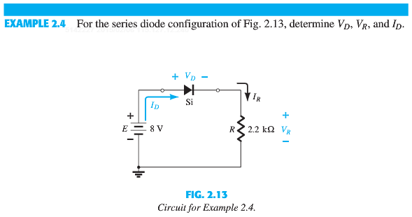
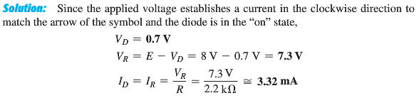

Slide 11
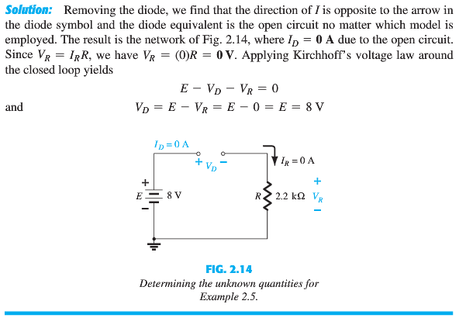

Slide 12
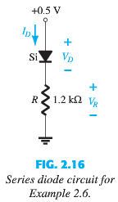
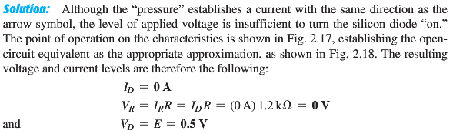
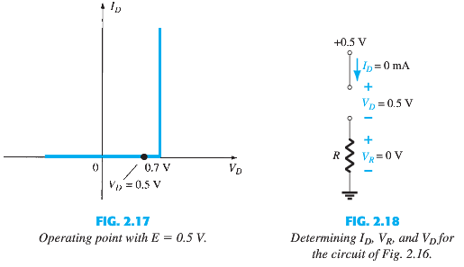

Slide 13
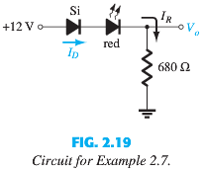
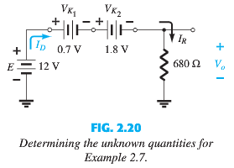
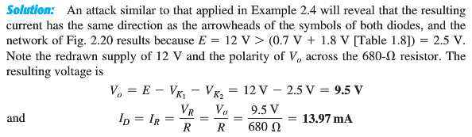
Assume 1.8V forward voltage drop for the red LED.

Slide 14
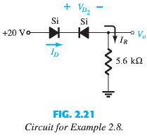
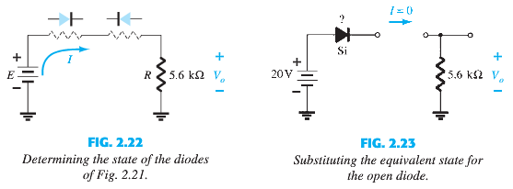
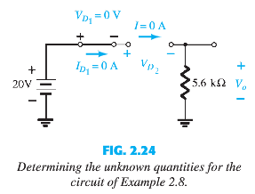
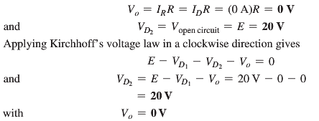
For an actual practical diode, when
I_{D} = 0 A, V_{D} = 0 V (and vice versa) No Bias condition

Slide 15
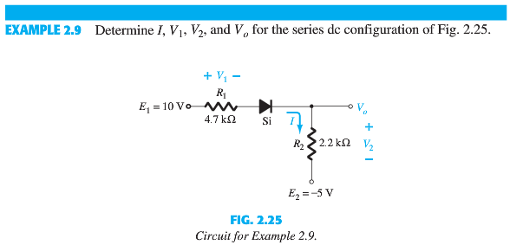
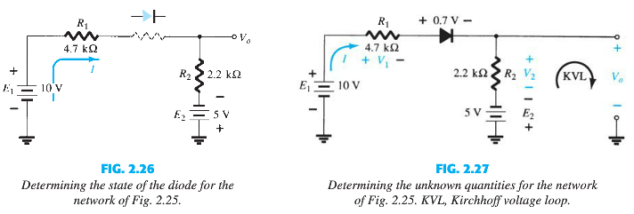
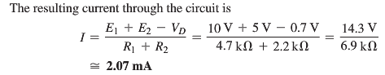
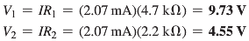
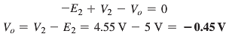

Slide 16
2.4 PARALLEL AND SERIES–PARALLEL CONFIGURATIONS
The methods applied for series diode configurations can be extended to the analysis of parallel and series–parallel configurations.
For each area of application, simply match the sequential series of steps applied to series diode configurations.

Slide 17
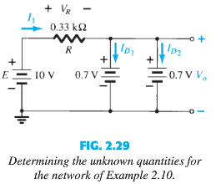
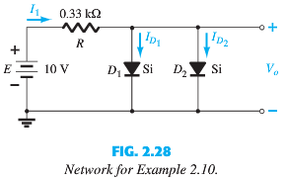
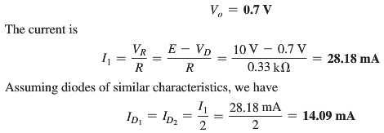

Slide 18
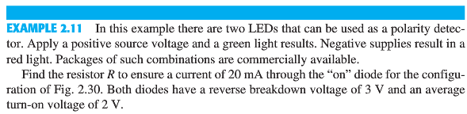
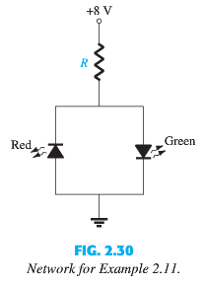
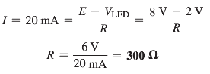

Slide 19
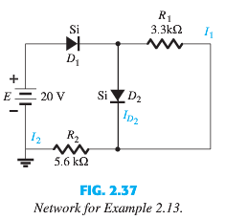
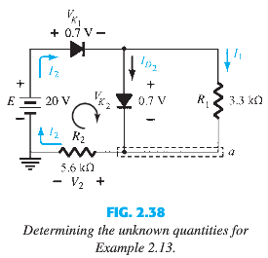
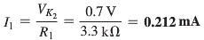
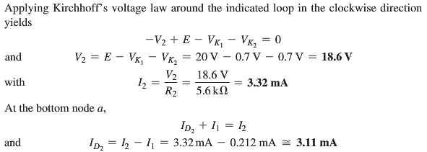

Slide 20
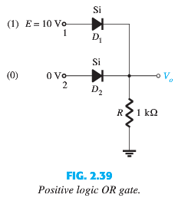
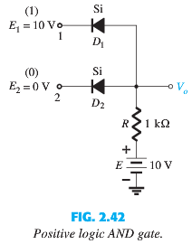
2.5 AND/OR GATES

Slide 21
Quiz 2
24/06/2019: Monday
Use 11th edition of the textbook
Syllabus: 2.2, 2.3 and 2.4
Examples:
Chapter 2: 2.4 – 2.13
Problems:
Chapter 2: 5, 6, 7, 8, 9, 10, 11, 12

Slide 22
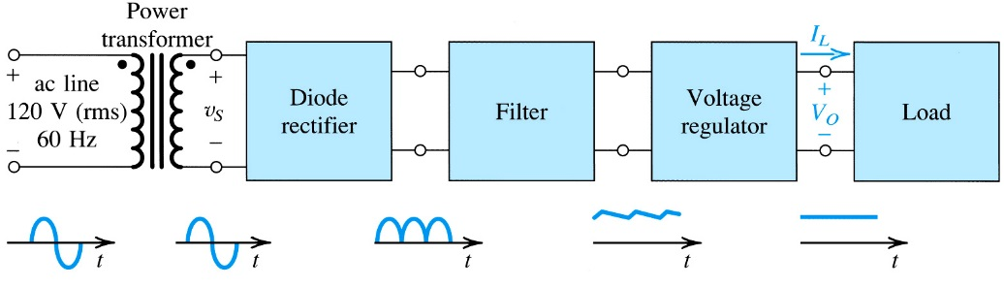
Rectifier Circuits
One important application of diode is the rectifier
Converts AC to DC
Used to make dc power supplies
Figure: Block diagram of a dc power supply

Slide 23
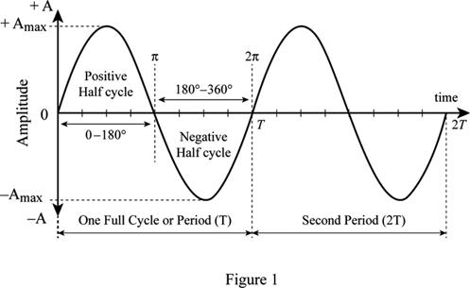
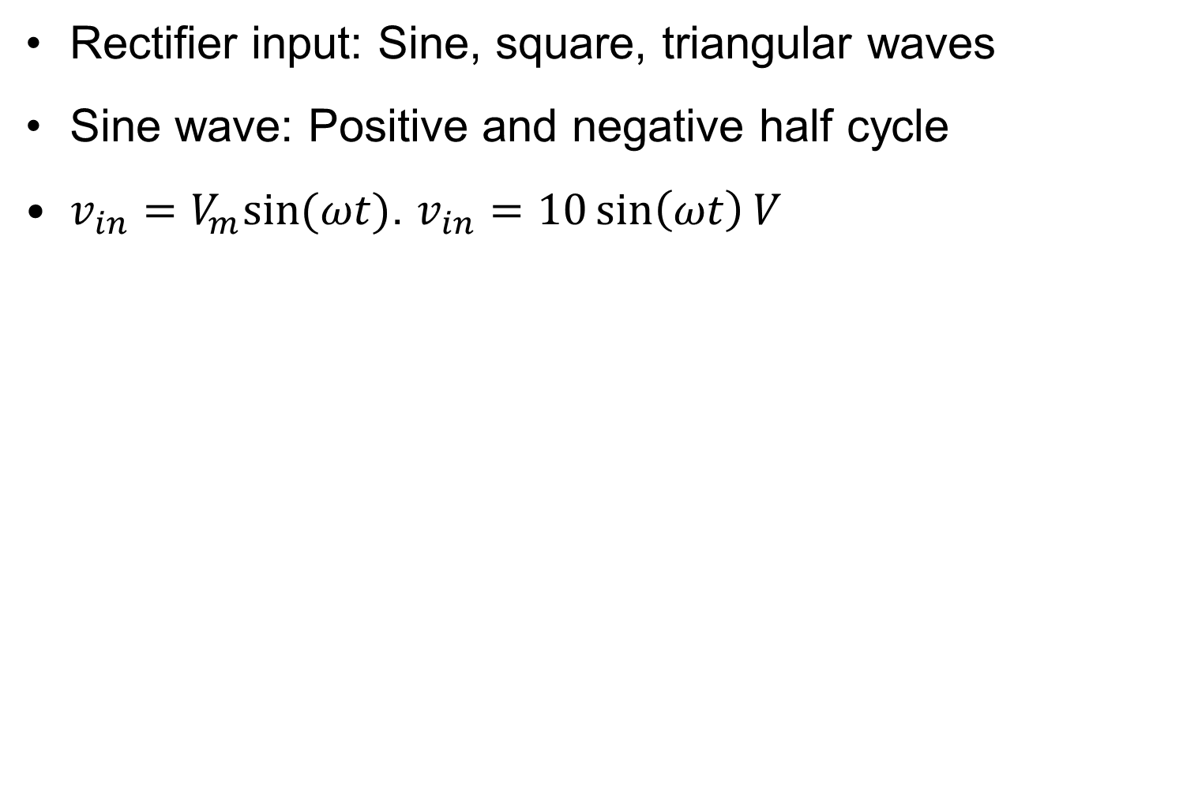
Input AC signal
Rectifier input: Sine, square, triangular waves
Sine wave: Positive and negative half cycle
$v_{in}=V_{m}sin⁡(ωt)$. $v_{in}=10\sin\left(ωt\right)V$

Slide 24
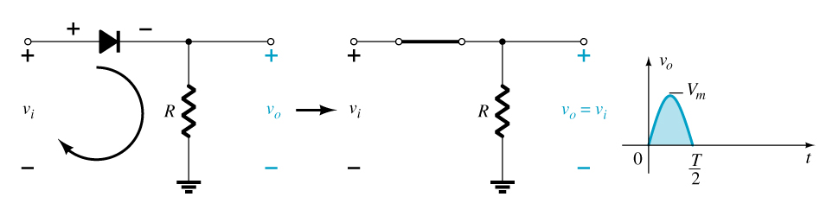
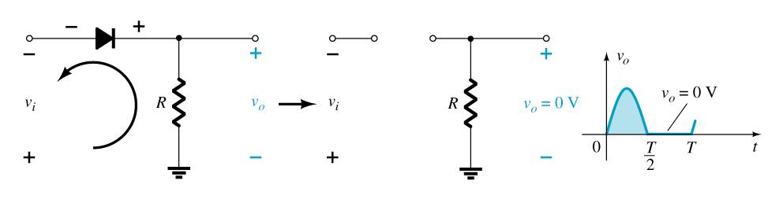
2.6 Half-Wave Rectification
The diode conducts only when it is forward biased, therefore only half of the AC cycle passes through the diode to the output.
The DC output voltage is 0.318V_{m}, where V_{m} = the peak AC voltage.

Slide 25




2.6 Half-Wave Rectification
The process of removing one-half the input signal to establish a dc level is called half-wave rectification
Ideal Approximation

Slide 26


The effect of using a real diode

Slide 27

The Half-Wave Rectifier

Slide 28





which is a difference that can certainly be ignored for most applications.

Slide 29

PIV (PRV)
The diode is only forward biased for one-half of the AC cycle. It is also reverse biased for one-half cycle.
It is important that the reverse breakdown voltage rating of the diode be high enough to withstand the peak, reverse-biasing AC voltage.
PIV (or PRV) > V_{m}
Where PIV = Peak inverse voltage
PRV = Peak reverse voltage
V_{m} = Peak AC voltage

Slide 30


2.7 Full-Wave Rectification
The rectification process can be improved by using a full-wave rectifier circuit.
Full-wave rectification: output for both positive and negative half cycle
Full-wave rectification produces a larger DC output:
Half-wave: V_{dc} = $\frac{V_{m}}{π}$ = 0.318V_{m}
Full-wave: V_{dc} = $\frac{2∗V_{m}}{π}$ = 0.636V_{m}

Slide 31




Full-Wave Rectification
Bridge Rectifier
A full-wave rectifier with four diodes that are connected in a bridge configuration

Slide 32



The effect of using a real diode

Slide 33



Full-Wave Rectification
Center-Tapped Transformer Rectifier
Needs a bigger transformer, because the peak is only half the secondary voltage.
Requires two diodes and a
center-tapped transformer.
(+) half cycle: $D_{1}$ ON; $D_{2}$ OFF
(-) half cycle: $D_{1}$ OFF; $D_{2}$ ON
V_{DC} = 0.636V_{m}

Slide 34



Summary of Rectifier Waveforms
Half-Wave Rectifier
Full-Wave Rectifier
Bridge Rectifier

Slide 35
Summary of Rectifier Circuits
In the center tapped transformer rectifier circuit, the peak AC voltage is the transformer secondary voltage to the tap.
Rectifier | Ideal V_{DC} | Realistic Si V_{DC}
Half Wave Rectifier | V_{DC}= 0.318V_{m} | V_{DC} = 0.318(V_{m} – 0.7V)
Bridge Rectifier | V_{DC} = 0.636V_{m} | V_{DC} = 0.636(V_{m} – 2(0.7 V))
Center-Tapped Transformer Rectifier | V_{DC} = 0.636V_{m} | V_{DC} = 0.636(V_{m} – 0.7 V)
V_{m} = the peak AC voltage

Slide 36





Slide 37

The Rectifier with a Filter Capacitor - The Peak Rectifier

Slide 38


The Peak Rectifier with a Load Resistor – A More Practical Circuit

Slide 39


The full-wave peak rectifier
The ripple is smaller than half-wave rectifier
$V_{r}= \frac{V_{p}}{C∗R_{L}}$
Ripple voltage inversely proportional to filter capacitor

Slide 40
2.8 Diode Clippers
Clippers are networks that employ diodes to “clip” away or removes a portion of an input signal without distorting the remaining part of the applied waveform.
The half-wave rectifier is an example of the simplest form of diode clipper—one resistor and a diode.
Depending on the orientation of the diode, the positive or negative region of the applied signal is “clipped” off.
Two general categories of clippers: series and parallel.
Series clippers: The diode in series with the load
Parallel clippers: The diode in parallel to the load

Slide 41


Diode Series Clippers
The diode in a series clipper “clips” any voltage that does not forward bias it:
Series Clipper: Diode and Load resistance ($R_{L}$) in series
Clips negative portion of the input: Negative Clipper
A reverse-biasing polarity
A forward-biasing polarity less than 0.7 V (for a silicon diode)

Slide 42


Biased Clippers
Adding a DC source in series with the clipping diode changes the effective forward bias of the diode.
Biased Clipper: A DC source also present in the circuit
Series Clipper
Negative Clipper

Slide 43








Positive half cycle
Diode FB/ON/Short
KVL: $−20V−5V+V_{o}=0$
$$V_{o}=25V$$
Negative half cycle
Diode RB/OFF/Open
$I_{D}=0A$
$$V_{o}=0V$$

Slide 44


Parallel Clippers
The diode in a parallel clipper circuit “clips” any voltage that forward biases it.
DC biasing can be added in series with the diode to change the clipping level.
Parallel Clipper: Diode and Load resistance ($R_{L}$) in parallel
Clips positive portion of the input: Positive Clipper

Slide 45






Positive half cycle
Diode RB/OFF/Open
$$V_{o}=V_{in}=20V$$
Negative half cycle
Diode FB/ON/Short
$$V_{o}=4V$$

Slide 46



Slide 47

Summary of Clipper Circuits

Slide 48

Summary of Clipper Circuits

Slide 49


2.9 Clampers
A clamper is a network constructed of a diode, a resistor, and a capacitor that shifts a waveform to a different dc level without changing the appearance of the applied signal.
Clamping networks have a capacitor connected directly from input to output with a resistive element in parallel with the output signal.
The diode is also in parallel with the output signal but may or may not have a series dc supply as an added element.
Peak-peak or swing of input and output must be same.

Slide 50




2.9 Clampers
Negative half cycle: Capacitor discharges. Capacitor voltage and polarity will not change.
Diode RB/OFF. Find output ($v_{o}$).
$$v_{o}≠0V.$$
KVL: $+V_{in}+V+v_{o}=0↔v_{o}=−2V_{in}$.
Peak-peak or swing of input and output
must be same
Check in which cycle diode is FB/ON?
Positive half cycle.
Positive half cycle: Capacitor charges. Diode FB/ON.
Find capacitor voltage ($V$). Find output ($v_{o}$).
$$v_{o}=0V.$$
KVL: $−V_{in}+V=0↔V=V_{in}$.

Slide 51





Slide 52

Summary of Clamper Circuits

Slide 53


Biased Clamper Circuits with sine input
The input signal can be any type of waveform such as a sine, square, or triangle wave.
The DC source lets you adjust the DC camping level.

Slide 54


2.11 Zener Diodes
Zener diode works exactly similar as Semiconductor diode in Forward Bias (FB)
The Zener is a diode that is operated in reverse bias at the Zener Voltage (V_{z}).
RB: When V_{i} ≥ V_{Z}
The Zener is on
Voltage across the Zener is V_{Z}
Zener current: I_{Z} = I_{R} – I_{RL}
The Zener Power: P_{Z} = V_{Z}I_{Z}
RB: When V_{i} < V_{Z}
The Zener is off
The Zener acts as an open circuit

Slide 55

Approximate equivalent circuits for the Zener diode in the three possible regions of application
Reverse Bias (RB): OFF
Forward Bias (FB)
Reverse Bias (RB): ON

Slide 56




Slide 57






Slide 58





Slide 59





Slide 60





Slide 61
Please write the following things on your exam paper and take your CLEAR picture with the First Page.
You can take the picture and save it on your phone NOW.
Write your Name and NSU ID.
Write the Course Name, Course Code and section number. Analog Electronics I (EEE111.8)
Write the following pledge. "I affirm that I have not given or received any unauthorized help on this exam, and that all work are my own".
Clearly sign below the pledge.
Give page numbers for ATLEAST 8 pages

Slide 62

$X$ = 6th digit of your NSU ID
Example: If 1632345042 is your ID, then $X$ = 4.
You MUST have to submit before 12:50 PM
You can submit PDF or JPG
If you miss any page, send me a private comment ASAP

